Slide 1


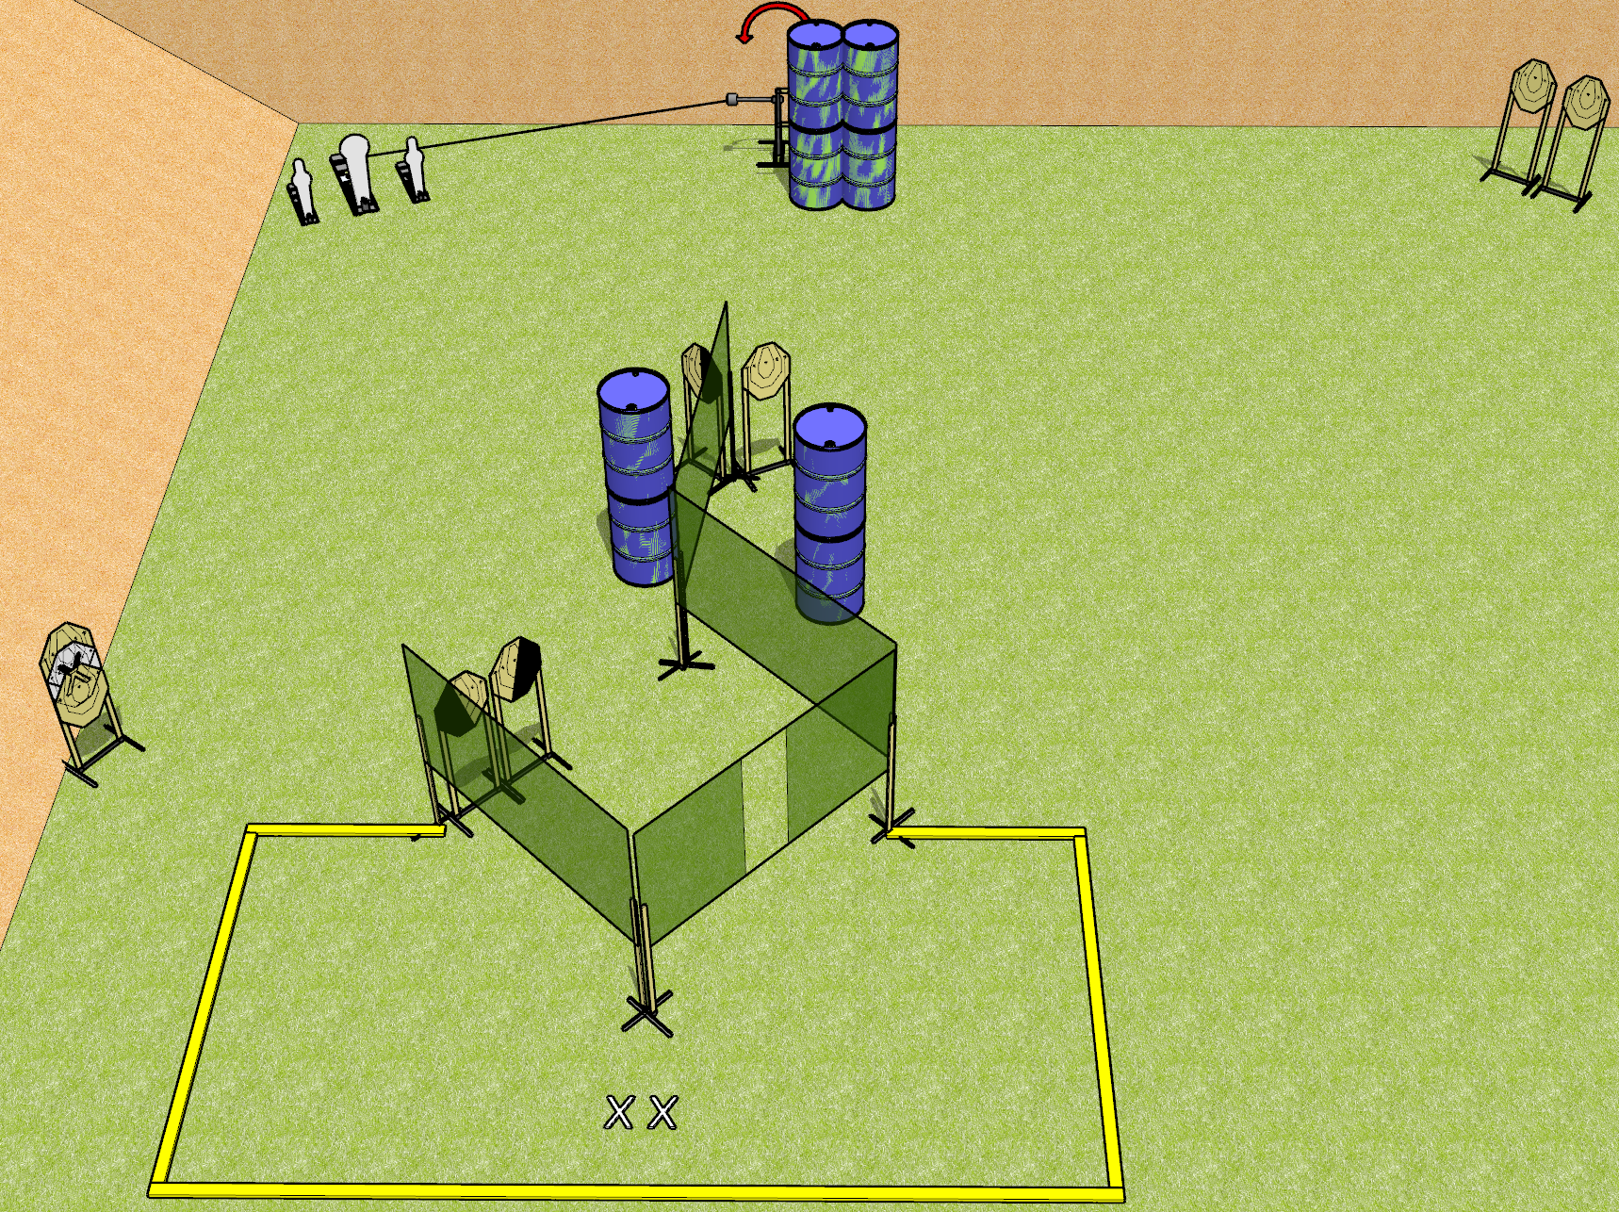
 | Dothan Gun Club – USPSA Match Watch This Course Designer : Drew Coleman
Round Count 21 rounds 9 IPSC 2 minis, 1 colt
Equipment List 6 wall feet 2 medium fault lines 2 diagonal, 1 right HC (down the middle) 1 swinger + activator

Slide 2
Watch This
Written Stage Briefing
Watch This is a 21 round, 110 point, Comstock course of fire. There are 9 ISPC targets, 2 mini poppers, and 1 colt popper. The best 2 hits on paper will score, and steel must fall to score. The start signal is audible.
The swinger is activated by the colt popper, and remains visible at rest.
Handgun start position is both feet on X’s, wrists below belt. Handgun is loaded and holstered.
PCC start position is both feet on X’s, stock on belt. Loaded carbine is held with both hands, stock on belt, safety on.
On start signal, engage targets as they become available from within the shooting area.

